Slide 1
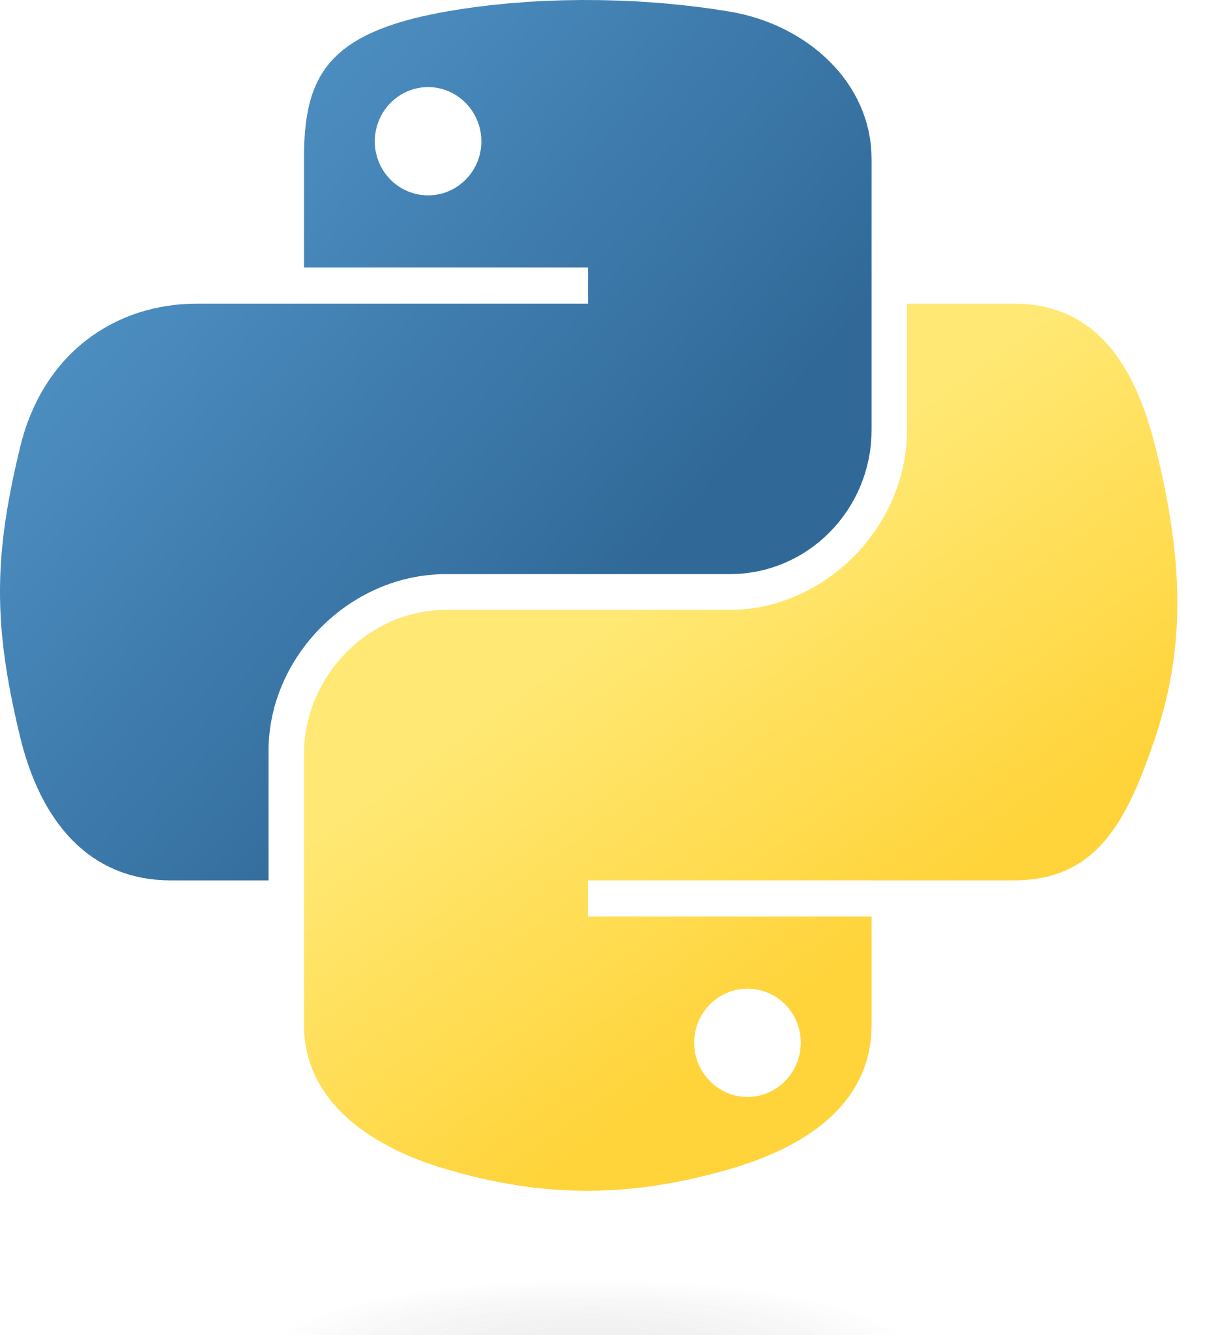
Python Programming
A Project Based Approach to Learning Python

Slide 2
Methods
Reusable Code To Achieve A Desired Output

Slide 3
Pseudo Code Example:
#Methods (or Functions) allow pieces of code to be reused
#when a repetitive task is defined. Pseudo code might help
#plan your programs actions:
Should I bring an umbrella?
If raining, Yes Bring Umbrella
Else, No
Start walking to school
If raining, Yes go back and get one
Else continue on
Go classes until days end
If raining, Yes get from locker
Else continue on

Slide 4
Method Example:
#Functions
def getUmbrella(weather):
if weather == "True":
print("Get an umbrella!")
else:
print("Nah, we're good. Leave it")
#Start of Program
print("--------------------------------")
print("Another new day! Let's get ready!\nShould I bring and umbrella?")
print("--------------------------------")
weather = input("Is it Raining? (True/False): ")
getUmbrella(weather)
print("Walking to School, Lets check the weather again...")
weather = input("Is it Raining? (True/False): ")
getUmbrella(weather)

